Slide 1
LCS Final project
By Sepehr Kalanaki
Teacher : Dr.Towhidkhah
TA : Mr.Amiri
1st semester of 1400-1401

Slide 2
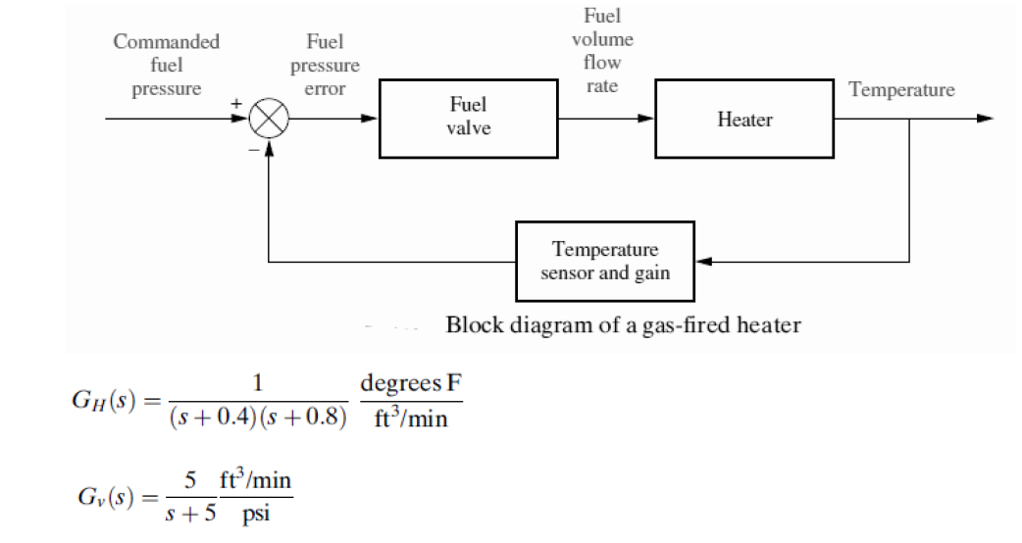
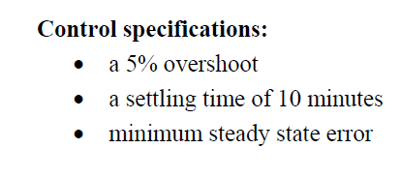
Which System to Control?

Slide 3
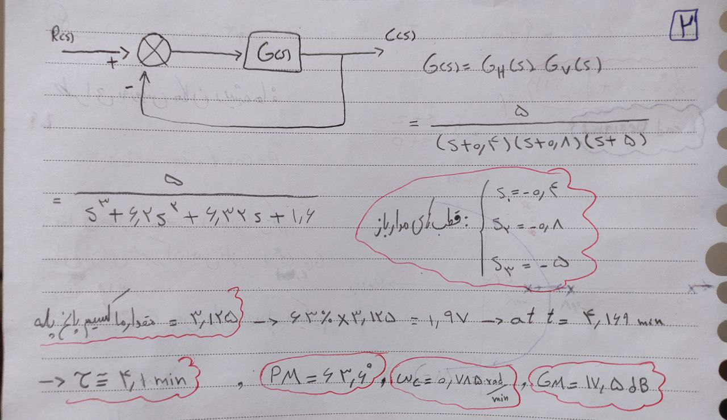
Open Loop Specifications:

Slide 4
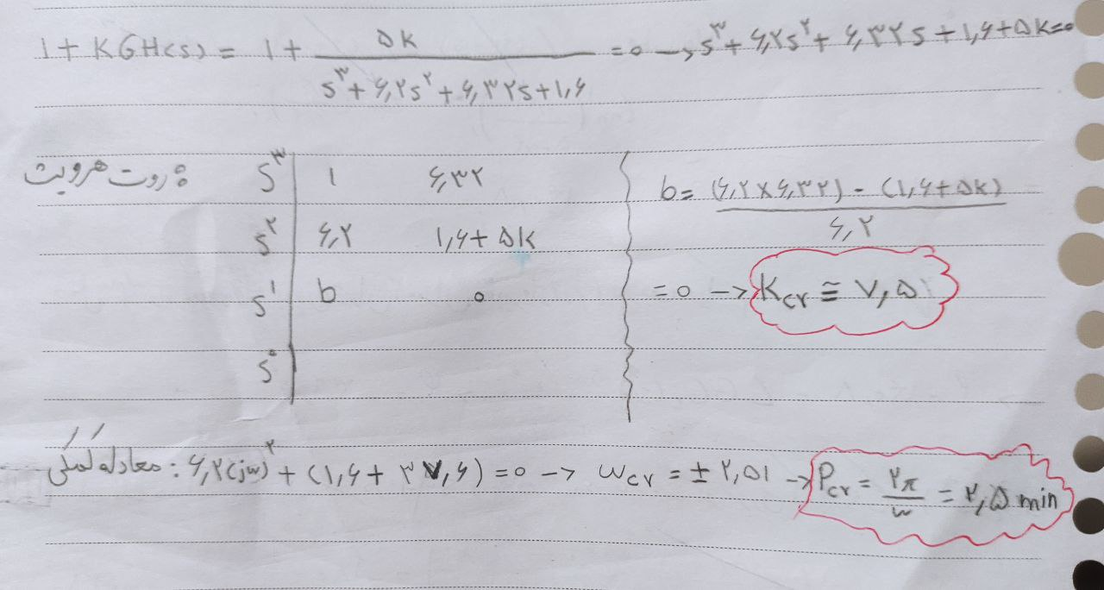
Open Loop Specifications:
4

Slide 5
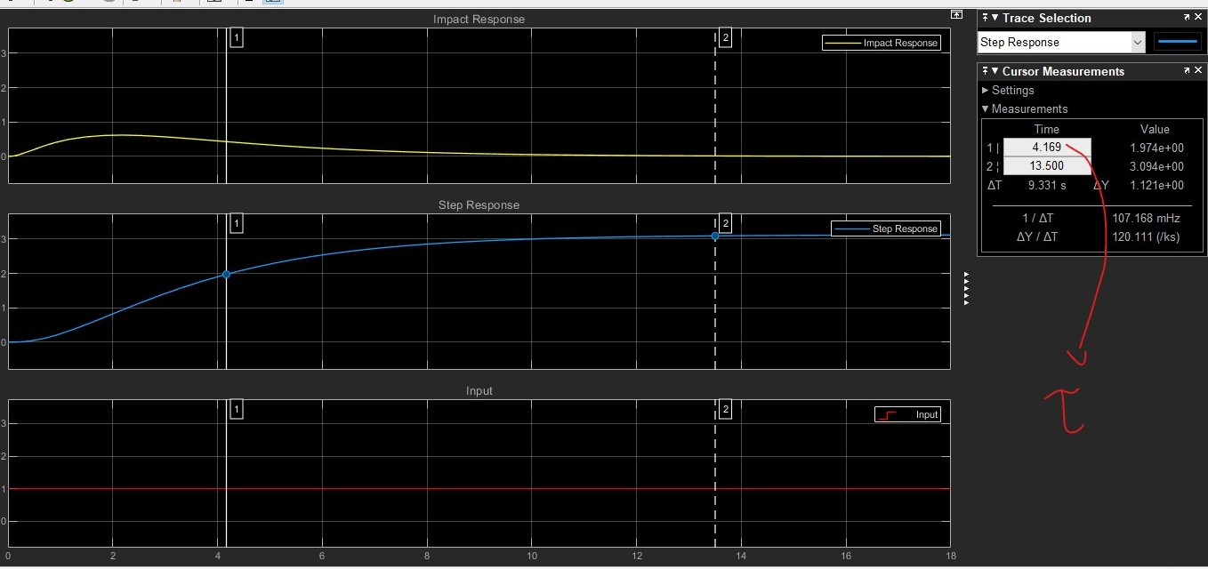
Open Loop Specifications:
Simulink: 2.1

Slide 6
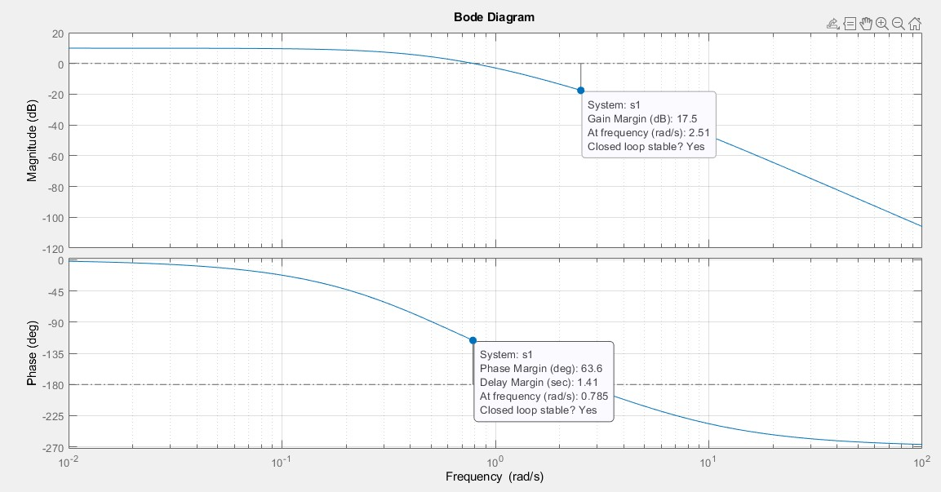
Open Loop Specifications:
Bode Diagram of G(s)
6

Slide 7
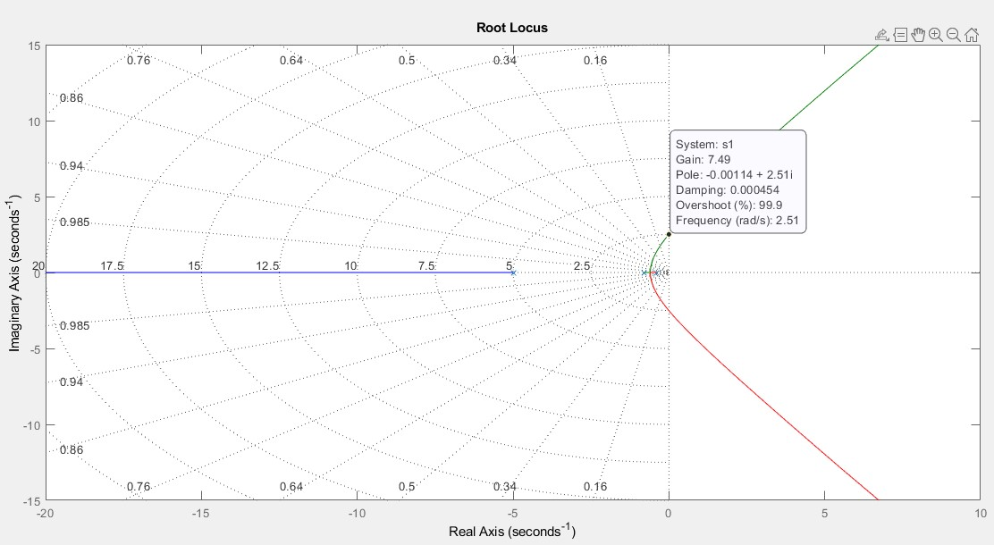
Open Loop Specifications:
Root Lucas of G(s)

Slide 8
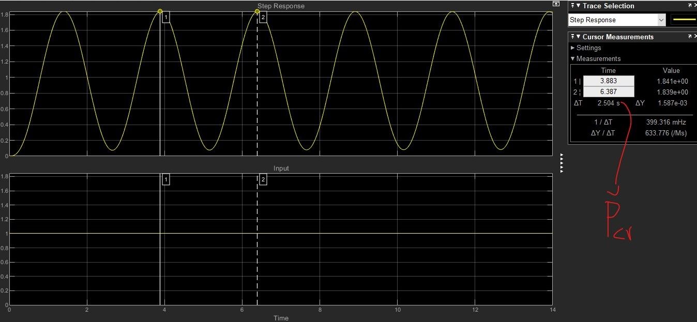
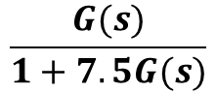
Closed loop response with k = kcr
Simulink: 2.2
Step response of :
$$\frac{G(s)}{1+7.5G(s)}$$
8

Slide 9
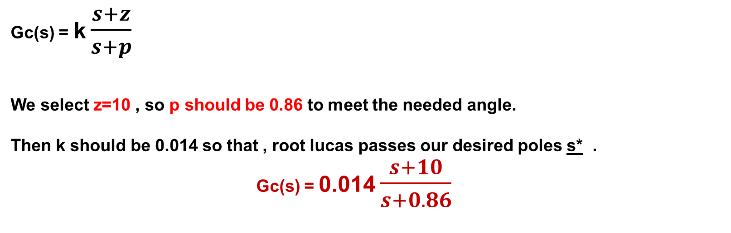
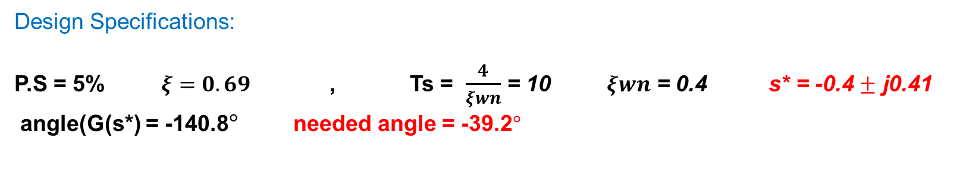
Design Compensator via Root Lucas
Design Specifications:
P.S = 5% $ξ=0.69$ , Ts = $\frac{4}{ξwn}$ = 10 $ξwn$ = 0.4 s* = -0.4 $±$ j0.41
angle(G(s*) = -140.8$°$ needed angle = -39.2$°$
Lag design:
Simulink: 3.10
Gc(s) = k $\frac{s+z}{s+p}$
We select z=10 , so p should be 0.86 to meet the needed angle.
Then k should be 0.014 so that , root lucas passes our desired poles s* .
Gc(s) = 0.014 $\frac{s+10}{s+0.86}$
9

Slide 10
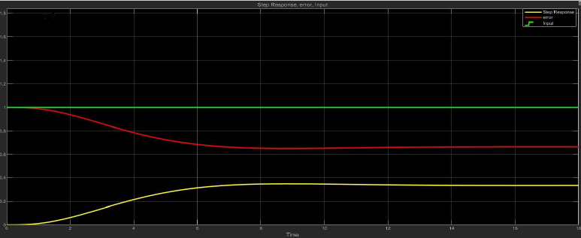
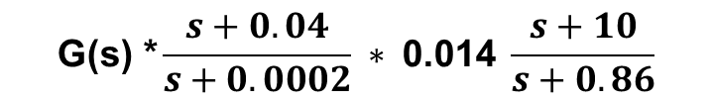
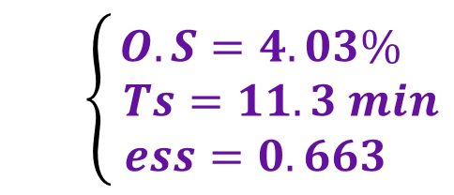
$$\text{G}\text{(}\text{s}\text{) ∗}\frac{s+0.04}{s+0.0002} ∗ \text{0.014} \frac{s+10}{s+0.86}$$
Closed loop Step response of :
$$\left\{\begin{aligned}O.S=4.03\% \\ Ts=11.3 min \\ ess=0.663 \end{aligned}\right.$$
*
10

Slide 11
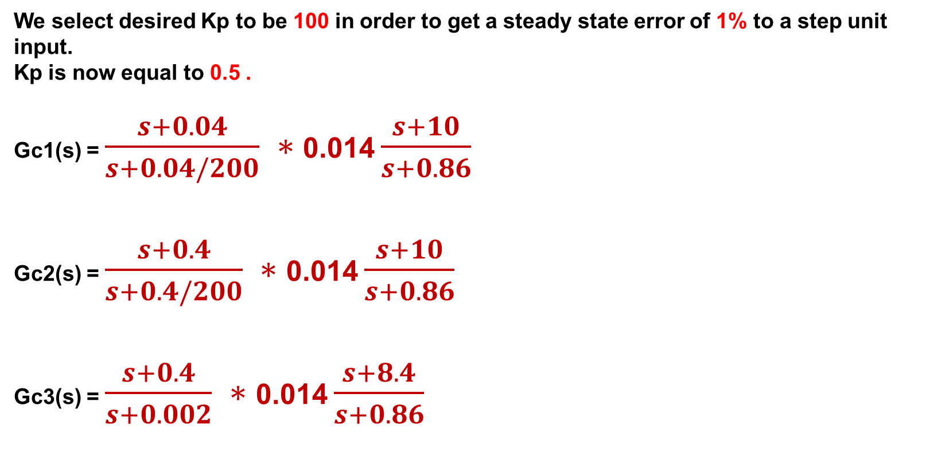
Lag Improvement
Simulink: 3.11 & 3.12 & 3.13
We select desired Kp to be 100 in order to get a steady state error of 1% to a step unit input.
Kp is now equal to 0.5 .
Gc1(s) = $\frac{s+0.04}{s+0.04/200} ∗$0.014 $\frac{s+10}{s+0.86}$
Gc2(s) = $\frac{s+0.4}{s+0.4/200} ∗$0.014 $\frac{s+10}{s+0.86}$
Gc3(s) = $\frac{s+0.4}{s+0.002} ∗$0.014 $\frac{s+8.4}{s+0.86}$
11

Slide 12
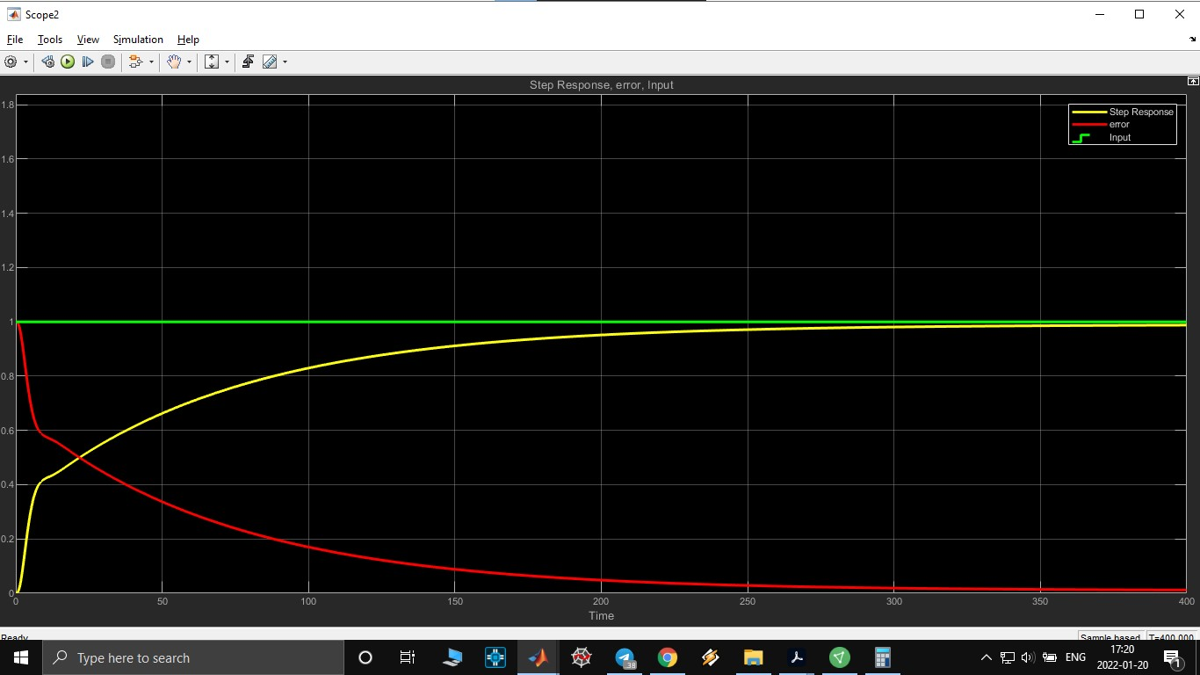
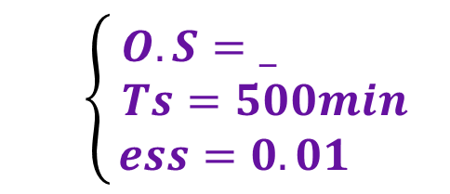
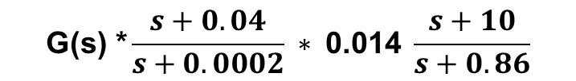
$$\text{G}\text{(}\text{s}\text{) }\text{∗}\frac{s+0.04}{s+0.0002} ∗ \text{0}\text{.}\text{014} \frac{s+10}{s+0.86}$$
Closed loop Step response of :
$$\left\{\begin{aligned}O.S=_ \\ Ts=500min \\ ess=0.01 \end{aligned}\right.$$
Gc1:
12

Slide 13
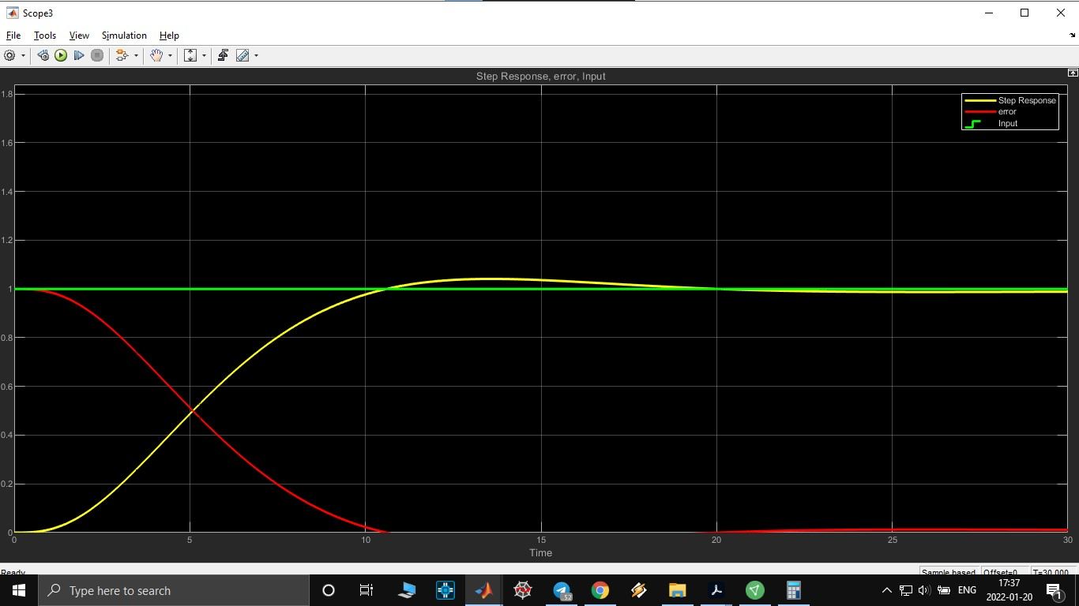
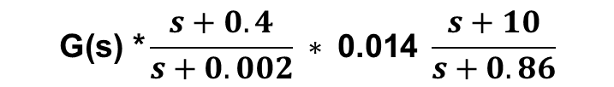
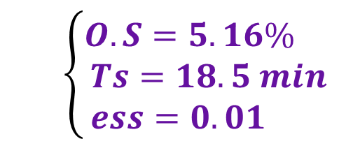
Closed loop Step response of :
$$\text{G}\text{(}\text{s}\text{) ∗}\frac{s+0.4}{s+0.002} ∗ \text{0.014} \frac{s+10}{s+0.86}$$
$$\left\{\begin{aligned}O.S=5.16\% \\ Ts=18.5 min \\ ess=0.01 \end{aligned}\right.$$
Gc2:
13

Slide 14
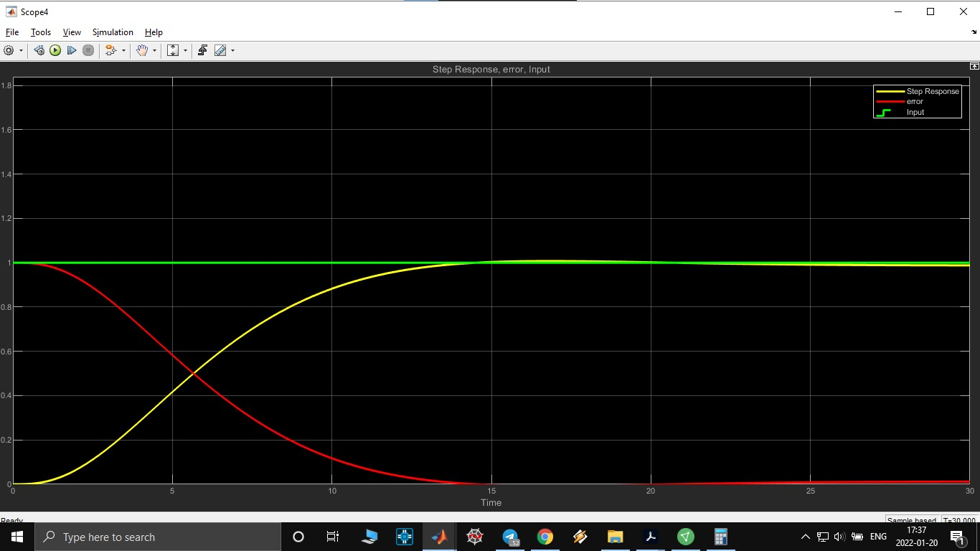

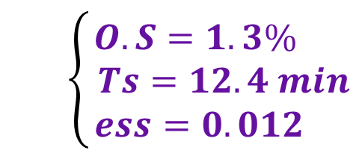
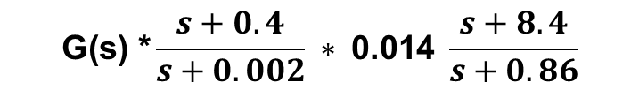
$$\text{G}\text{(}\text{s}\text{) }\text{∗}\frac{s+0.4}{s+0.002} ∗ \text{0}\text{.}\text{014} \frac{s+8.4}{s+0.86}$$
$$\left\{\begin{aligned}O.S=1.3\% \\ Ts=12.4 min \\ ess=0.012 \end{aligned}\right.$$
Gc3:
14

Slide 15
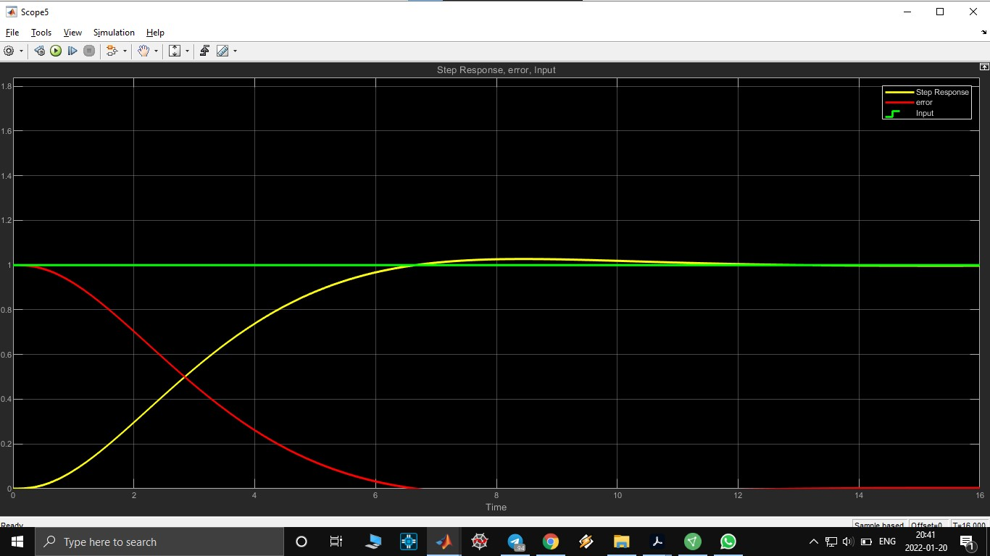
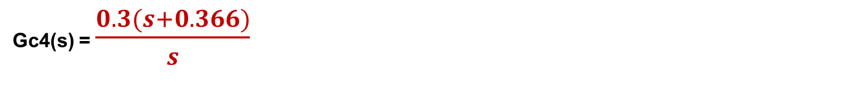
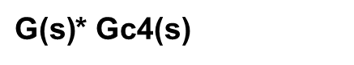
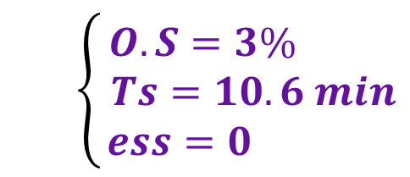
Design PI via Root Lucas
Simulink: 3.20
Gc4(s) = $\frac{0.3(s+0.366)}{s}$
$\text{G}\text{(}\text{s}\text{)}$* Gc4(s)
$$\left\{\begin{aligned}O.S=3\% \\ Ts=10.6 min \\ ess=0 \end{aligned}\right.$$
15

Slide 16
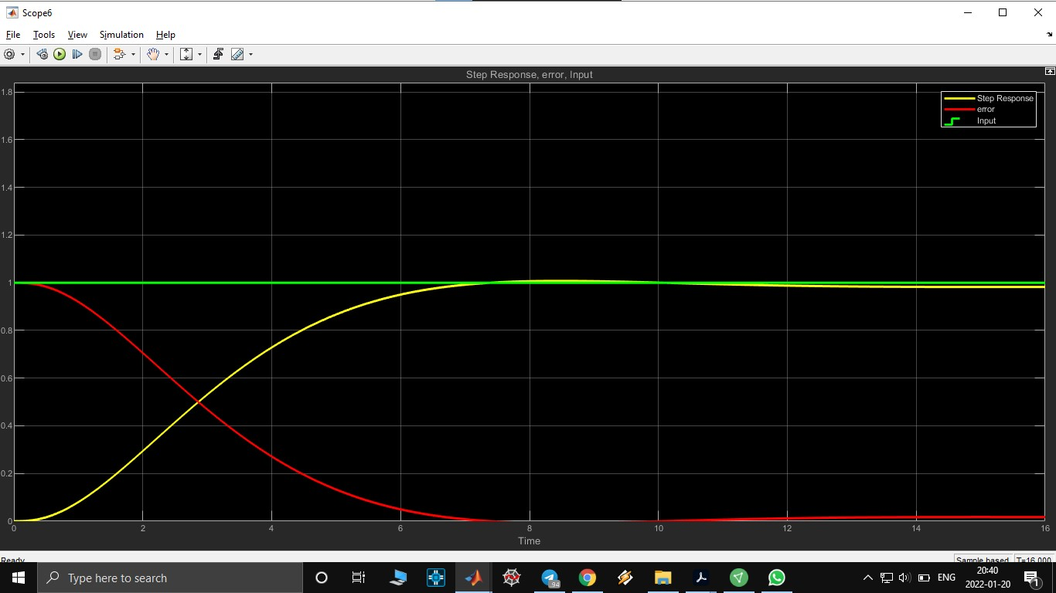
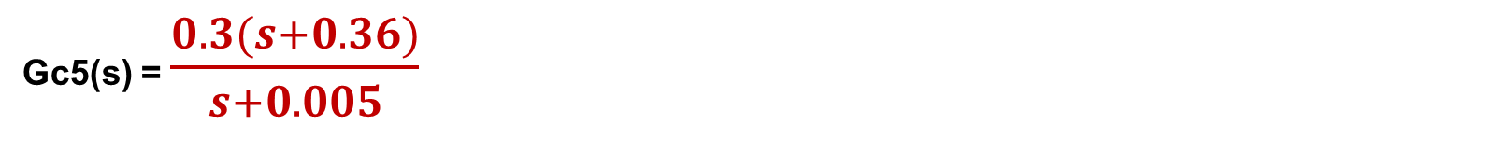
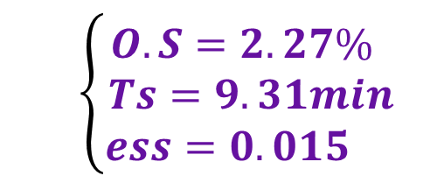
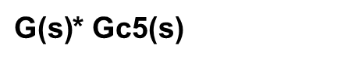
PI Upgrade
Simulink: 3.21
Gc5(s) = $\frac{0.3(s+0.36)}{s+0.005}$
$\text{G}\text{(}\text{s}\text{)}$* Gc5(s)
$$\left\{\begin{aligned}O.S=2.27\% \\ Ts=9.31min \\ ess=0.015 \end{aligned}\right.$$
√
16

Slide 17
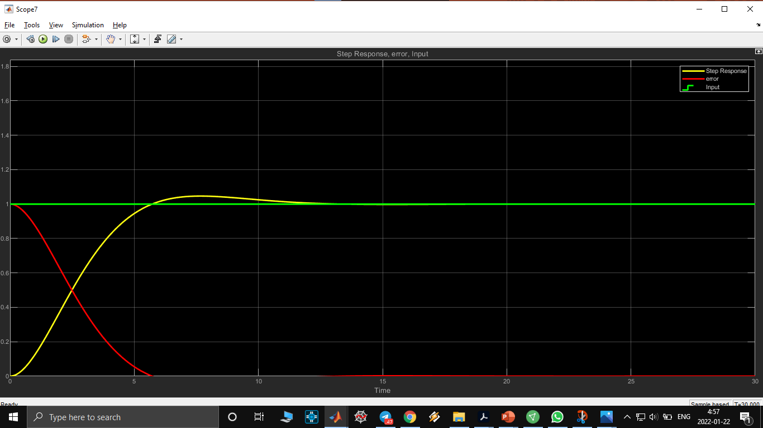
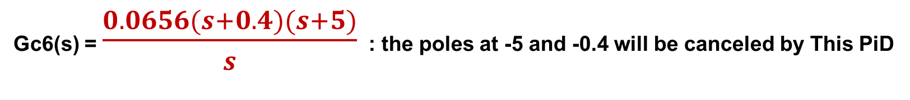
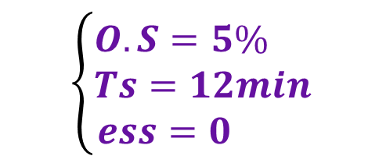
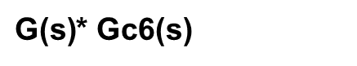
Design PID via Root Lucas
Simulink: 4.1
Gc6(s) = $\frac{0.0656(s+0.4)(s+5)}{s}$ : the poles at -5 and -0.4 will be canceled by This PiD
$\text{G}\text{(}\text{s}\text{)}$* Gc6(s)
$$\left\{\begin{aligned}O.S=5\% \\ Ts=12min \\ ess=0 \end{aligned}\right.$$
17

Slide 18
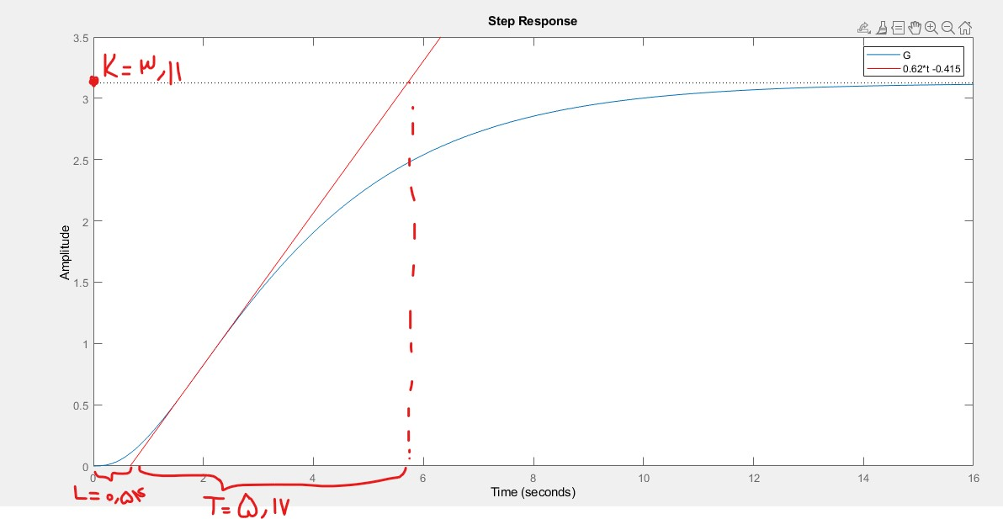
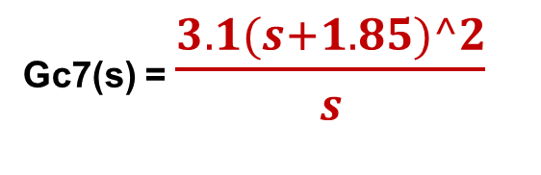
Design PID via Ziegler Nichols:(1st method)
Simulink: 4.20
Open Loop response of G(s) to a Unit Step input
Gc7(s) = $\frac{3.1(s+1.85)^2}{s}$
18

Slide 19
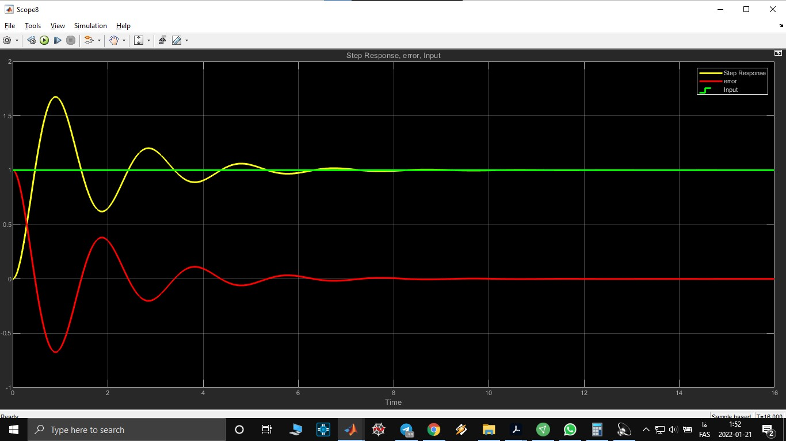
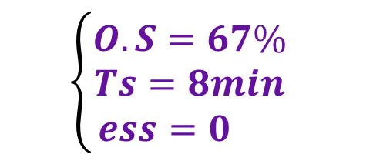
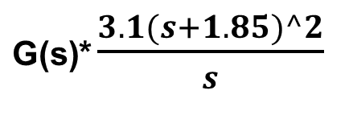
$\text{G}\text{(}\text{s}\text{)}$* $\frac{3.1(s+1.85)^2}{s}$
$$\left\{\begin{aligned}O.S=67\% \\ Ts=8min \\ ess=0 \end{aligned}\right.$$
19

Slide 20
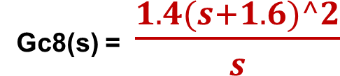
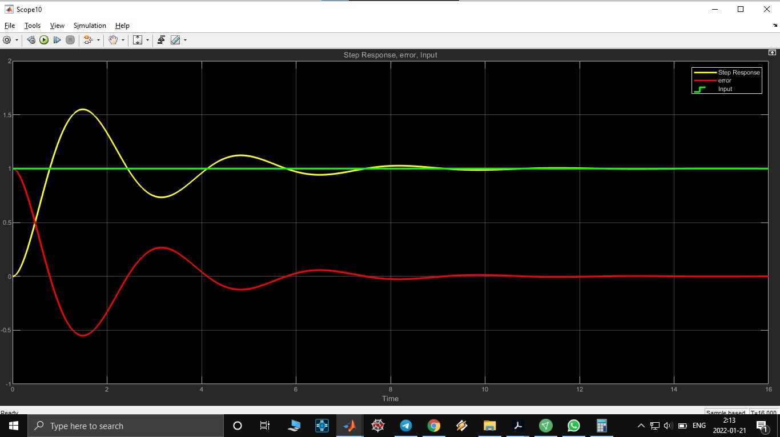
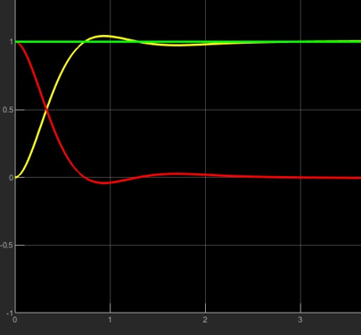
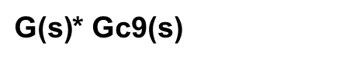
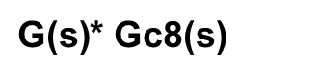
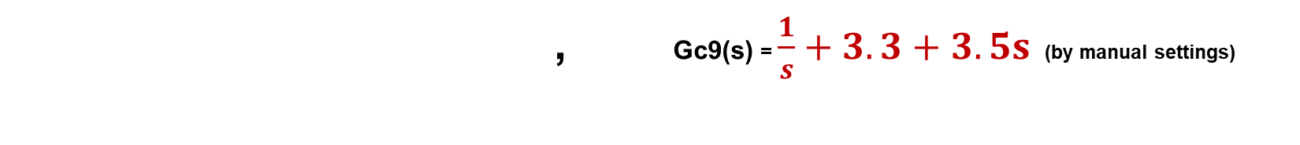
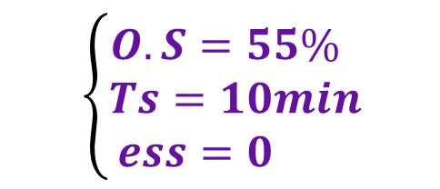
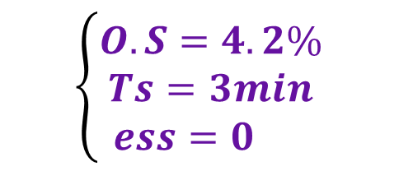
Design PID via Ziegler Nichols:(2st method)
Simulink: 4.30 & 4.31
, Gc9(s) = $\frac{1}{s}+3.3+3.5s$ (by manual settings)
$\text{G}\text{(}\text{s}\text{)}$* Gc8(s)
$\text{G}\text{(}\text{s}\text{)}$* Gc9(s)
$$\left\{\begin{aligned}O.S=55\% \\ Ts=10min \\ ess=0 \end{aligned}\right.$$
$$\left\{\begin{aligned}O.S=4.2\% \\ Ts=3min \\ ess=0 \end{aligned}\right.$$
√
20

Slide 21
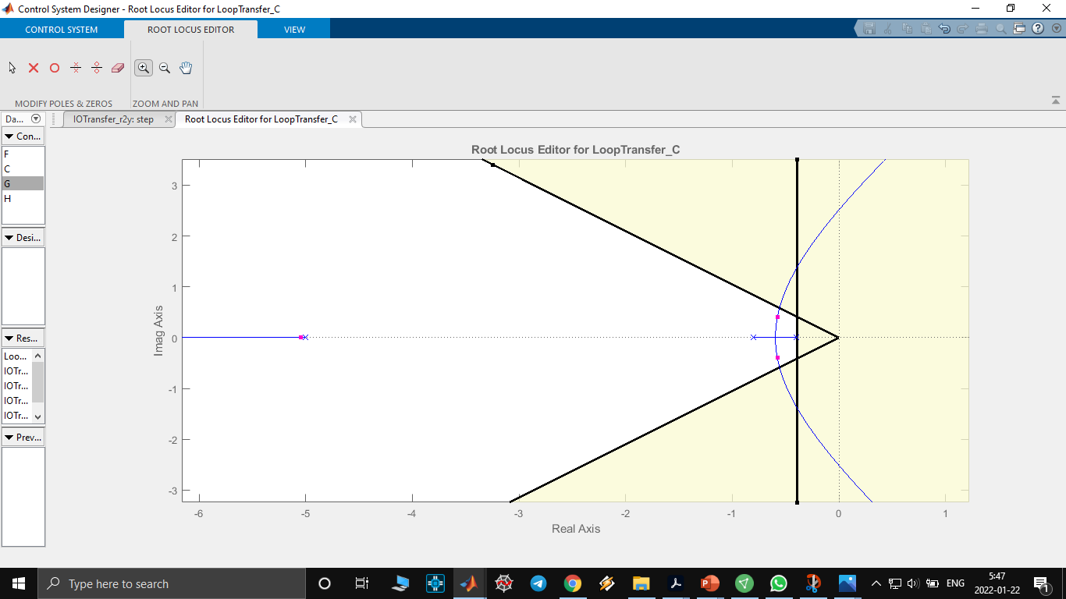

Controller Design Using ‘SISOtool’ in matlab:
21

Slide 22


Gc10(s) = $\frac{0.113(1+2.7s)}{s}$
We put a pole at zero and a zero at -0.38
22

Slide 23



$\text{G}\text{(}\text{s}\text{)}$* Gc10(s) = $\frac{0.113(1+2.7s)}{s}$
$$\left\{\begin{aligned}O.S=3.51\% \\ Ts=10.3min \\ ess=0 \end{aligned}\right.$$
√
23

Slide 24


State Space
24

Slide 25



25

Slide 26


State Feedback
26

Slide 27


27

Slide 28

Step response with state feedback demonstration
28

Slide 29

29

Slide 30


Step response with state feedback demonstration & a dc gain
$$\left\{\begin{aligned}O.S=4.6\% \\ Ts=11min \\ ess=0 \end{aligned}\right.$$
30

Slide 31



31

Slide 32

32

Slide 33


میتوان شبیه به سیسوتول با فیدبک حالت هم قطب های مطلوب مختلفی رو امتحان کرد و خروجی فیدبک حالت رو به آسانی مشاهده کرد
33

Slide 34


My System’s Function With an initial condition and zero input
34

Slide 35

My System’s Response To a Sine input ☹
35

